Slide 1
Josiah Royce Society Virtual Conference 2025
VARIETIES OF PROVINCIAL EXPERIENCE(S)
Aleksandar Feodorov
Institute for literature
Bulgarian academy of sciences oct 17, 2025

Slide 2
How I should and could read Royce’s “Provincialism” several thousand miles away from his own two provinces of California and New England and more than a century after he passed, and all that in the aftermath of the 20th century with its two world wars, a cold war and a very precarious contemporary situation in our confusing 21st century that witnesses a rise of various, possibly vicious, nationalisms, Europe not excluded, and all that in a global context of an ongoing and seemingly quite unjust and one-sided globalization?
WHY READ ROYCE TODAY?

Slide 3
1. Approaching Royce’s provincialism through debates from the 1960’s on the alleged provincialism of Bulgarian literature.
2. Approaching Royce’s provincialism in relation to a state of mind intimately connected to all forms of totalitarianism.
A PATH TO AN ANSWER

Slide 4
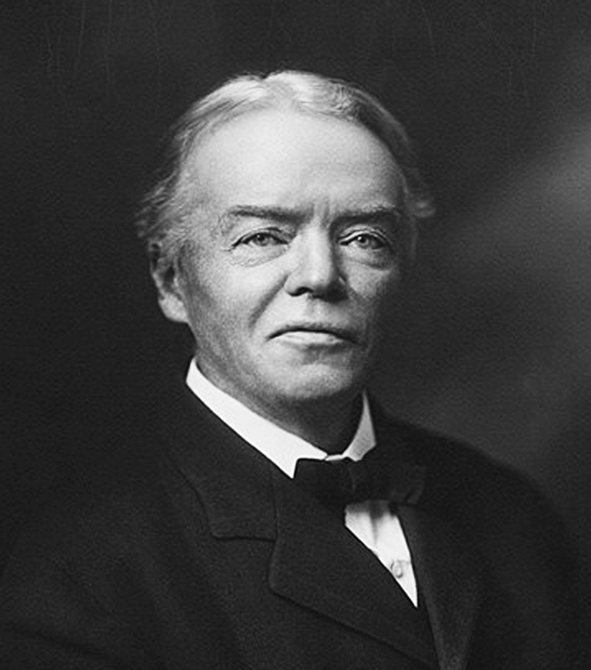
Royce’s Enlightened Provincialism
Two types of social consciousness
  a spirit alienated from itself is characteristic of a territorially vast state or empire.
  the provincial type of social consciousness, typical of smaller republics or provinces.

Slide 5
Royce’s Enlightened Provincialism
Three evils of modern civilization
  Many foreigners still not integrated in American communities.
  The leveling tendency of modern societies, hindering individualization and leading to conformist mediocrity.
  The rule of the mob – the poisonous double to the democratic spirit.

Slide 6
Royce’s Enlightened Provincialism
The four cures of provincialism
  Local pride is an ideal.
  Adopting values from outside.
  Free communication with other communities.
  Aesthetic ennoblement.

Slide 7

Palanka or SMALL-TOWN PHILOSOPHY
Radomir Konstantinović (1928–2011)
Radomir Konstantinović was a Serbian writer and philosopher. His most famous work is a philosophical treatise Filosofija palanke. He started his literary career as a poet. He published a book of poetry "Kuća bez krova" (House without a roof) in 1951 but then switched to writing a whole series of experimental novels.

Slide 8

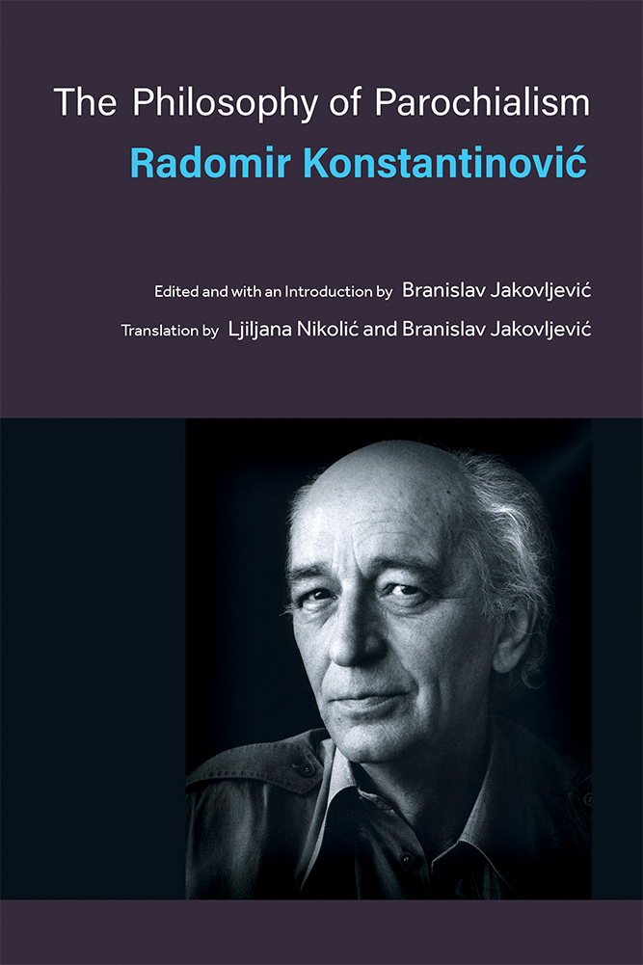
Palanka or SMALL-TOWN PHILOSOPHY
Filosofija Palanke (1969)
(Small Town Philosophy)
The Philosophy of Parochialism (2021)

Slide 9
Palanka or SMALL-TOWN PHILOSOPHY
“On the most superficial level, [the word] palanka translates as “province” or “small town.” However, both of these terms miss the semantic connotations that resonate with and contribute to some of the central insights of the book. Etymologically, palanka came into Serbian [and also into Bulgarian, I will add] from Hungarian […] and French […], designating a timber stockade, suggested by its Latin root word planca, meaning a board, plank, slab, or piece of timber. A palanka is a settlement that is enclosed, fortified, and on guard from the outside world, which it perceives as foreign and hostile. Like “province,” palanka designates a distinct place, a local [but unlike “province” it designates an] enclosed community, a township. These kinds of insulated groups are hotbeds of parochialism, a word that contains an apt designation of closed-mindedness characteristic of palanka [...] Hence, in this translation we used “province” and “parochialism” interchangeably to capture the spirit of Konstantinović’s palanka, the term that he used exclusively in his book to describe the phenomenon (no mention there of either “province” or “parochialism”)” (2021, p. 3).

Slide 10
Palanka or SMALL-TOWN PHILOSOPHY
“The world of the province exists only in spirit; the spirit of the province is itself an absolute province, unsurpassable by any provincial reality. It has no world of its own into which it could be perfectly materialized […] it appears as the spiritual originator of any aspiration to be enclosed in one’s own world, any aspiration to transform the world into the one of province [palanka]. In its experience the world lies somewhere beyond the hill, rather than in its own parochial universe, which is, in that sense, a non-world” (2021, p. 26).

Slide 11
Palanka or SMALL-TOWN PHILOSOPHY
style as the highest principle of parochialism.
the ideal of pure poverty.
the spirit of the tribe in agony.
atheism as the principle of publicness.
individualism as the function of parochialism.
lasting infantilism of the parochial spirit.
banality.

Slide 12
Palanka – SOME FURTHER QUESTIONS
Is there a province that is too small to be enlightened?
How can we even begin to measure whether a province is too closed and guarded against the world to be enlightened, or, on the other hand, too open as to lose its authenticity against the leveling tendency of modern civilization?

Slide 13
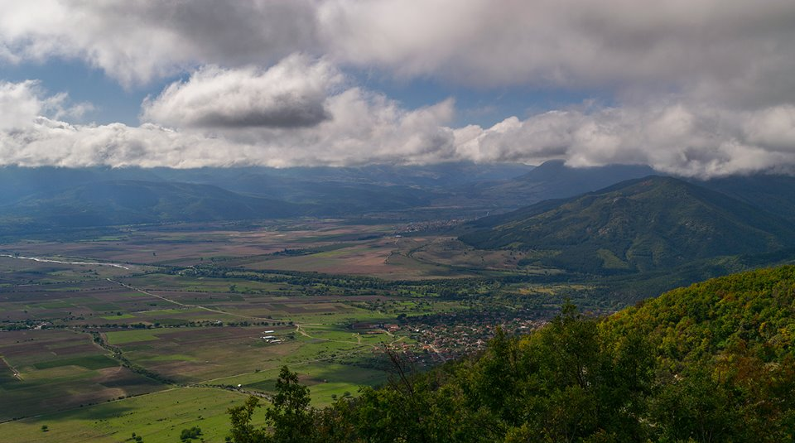
EMBRACING OR ESCPAING the kotlovina
котловина = depression
A depression is a landform sunken or depressed below the surrounding area.

Slide 14
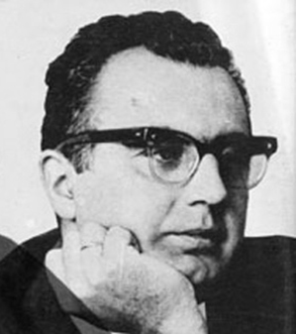
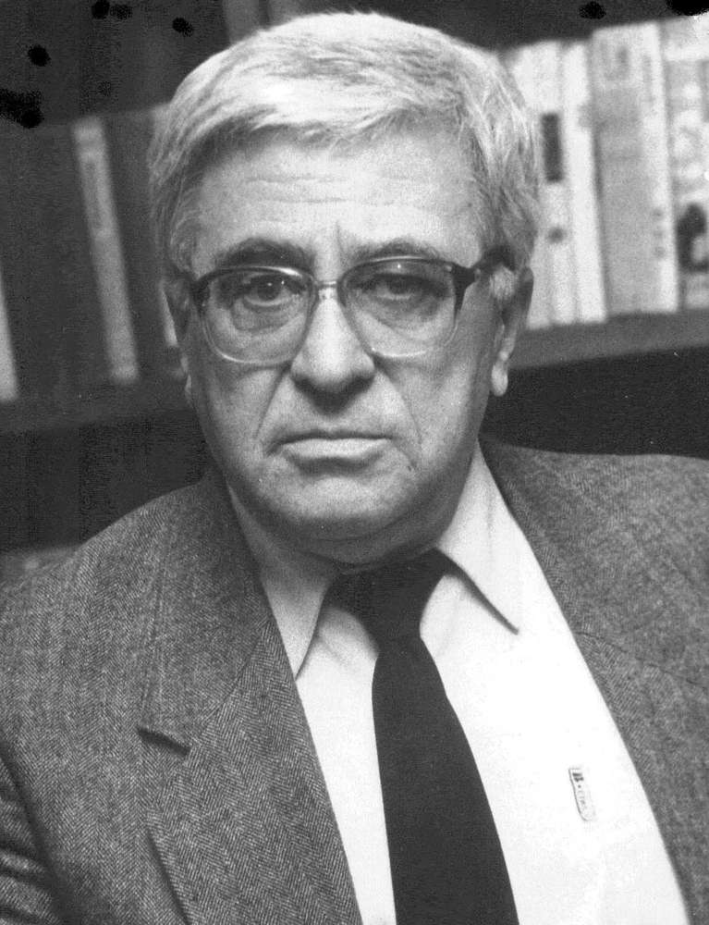
EMBRACING OR ESCPAING the kotlovina
Tsvetan Stoyanov (1930–1971)
Stoyanov was one of the best and most active Bulgarian translators from English and Russian in the 1950s and 1960s, with his own views on translation issues. Stoyanov's work covers works from various genres – essays, literary and socio-psychological studies, literary criticism, short stories, novels, travelogues, dialogues, journalism, and poetry. As a student, he contributed to periodicals with journalistic materials.
Toncho Zhechev (1929–2000)
Toncho Zhechev is one of Bulgaria's most prominent humanists. He writes in various genres – literary-historical essays, criticism, prose, journalism, and essays – and his research approach is primarily cultural-historical. Toncho Zhechev's observations are based on a penetrating insight into tradition, but also on a deep understanding of the essence of the phenomena that have shaped emblematic images in Bulgarian thinking.

Slide 15
EMBRACING OR ESCPAING the kotlovina
Toncho Zhechev (1929–2000)
Conservative revolution
Nativist thesis
Only by becoming more provincial then can Bulgarian literature become world-literature.
The “Faulkner Way”

Slide 16

EMBRACING OR ESCPAING the kotlovina
Tsvetan Stoyanov (1930–1971)
The Threads Cut Off: Ideas and Motives of Alienation in Western Literature (1967)

Slide 17
EMBRACING OR ESCPAING the kotlovina
Tsvetan Stoyanov (1930–1971)
Progressive and internationally oriented
Alienation
The dangers of the “Faulkner Way”
World literature becoming a zoo; national literature yielding to cultural imperialism; turning literature into a museum.

Slide 18
Kotlovina – some further Questions
In his The Threads Cut Off Stoyanov offers a severe critique of the philistine tendencies of alienation developing in modern societies regardless of them being capitalist or socialist. Royce’s loyalty and provincialism, we could consider a solution to alienation, a remedy for the “threads cut off”.
Could we envision a kind of literary provincialism that negates the dangers of the nativist thesis that serves to reconnect the “threads cut off”?

Slide 19
A Non-Conclusive Conclusion
Why read Royce today?
How can I use Royce not only in my scholarship, but also in my ordinary, everyday life today?
No Answer, but a Possible Approach
By engaging Royce’s work with authors such as those mentioned with the idea that culture is a form of communion.

Slide 20
THANK YOU for the attention

